Slide 1
ACADEMIC
RESOURCE
CENTER
Nilab Hussain, Kevin Tran, Kevin McGrath, Sang Chul Lee, and Mitchel Castellon

Slide 2
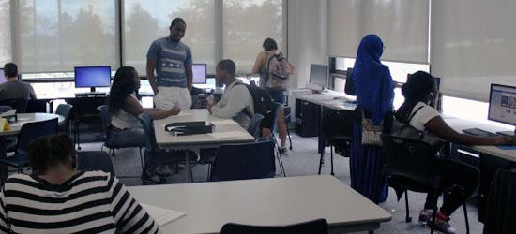
Academic Resource Center
A broad range of tutoring and coaching services
Cora P. Maloney College
Funding
Notes:
designed for the benefit of a variety of students involved in

Slide 3
Problem
Information was previously stored completely on paper, which made the system very prone to data inconsistencies
Searching for information was very time consuming as you had to look through data records manually
The ARC gets its support from third parties.. loss of evidence= loss of check.

Slide 4
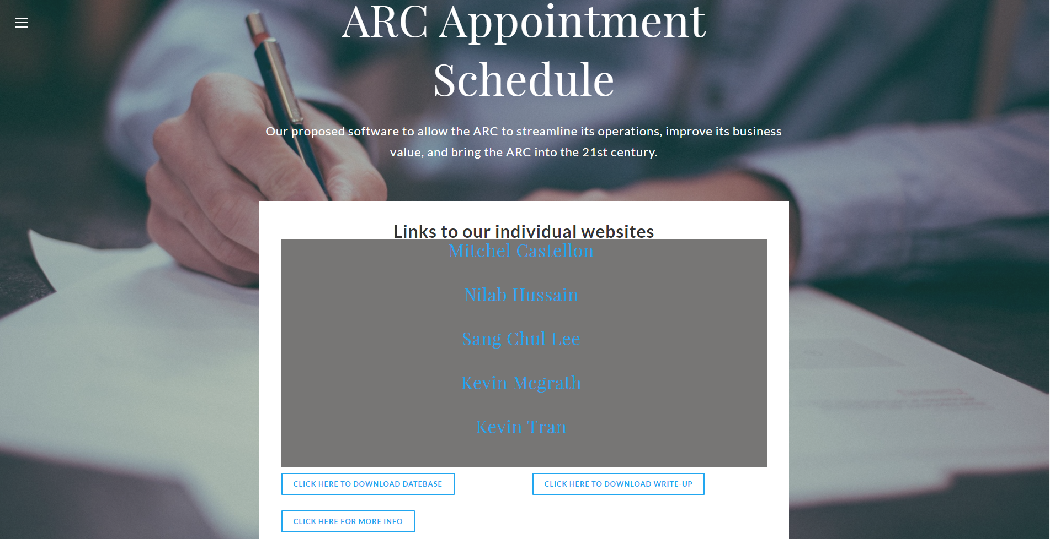
Solution
Access Database!

Slide 5
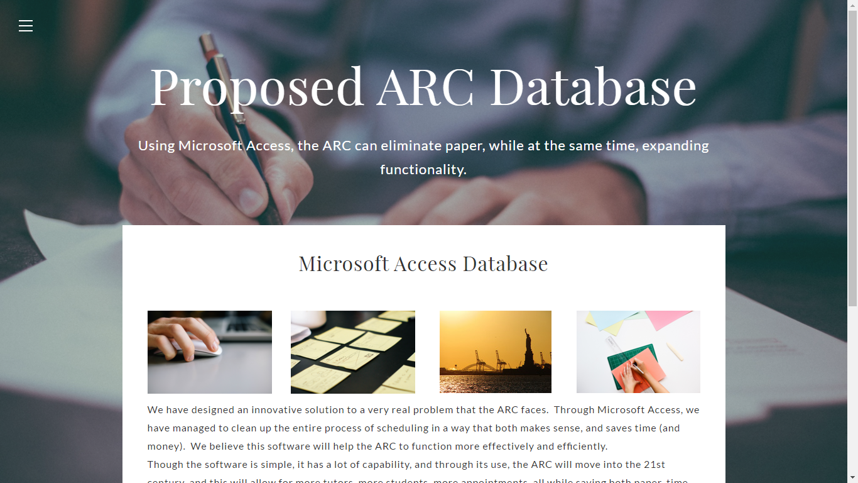
Final Project Website
http://mgs351a11group3.weebly.com/

